Slide 1

Agentic RAG-Based Citizen Service Advisory Chatbot
A source-grounded AI assistant for Citizen Service Centres — guiding users on public services, document requirements, identity issues, and next steps.
ARTIFICIAL INTELLIGENCE · DIGITAL GOVERNANCE

Slide 2



The Problem at Citizen Service Centres
Common Service Centres (CSCs) are India's primary G2C access points — yet citizens frequently arrive unprepared, causing repeated visits and inconsistent service.
Unclear Service Selection
Citizens often don't know which service applies to their situation.
Missing or Incomplete Documents
Visits fail because required documents are missing or incorrect.
Identity Mismatch Confusion
Name spelling differences, surname changes, and Aadhaar inconsistencies leave citizens unsure of next steps.
Operator Dependency
Guidance depends on individual memory, leading to inconsistency.

Slide 3




Why This Project Is Needed
CSCs handle high volumes daily. A reliable advisory tool can reduce confusion, improve preparedness, and standardize guidance.
Better Citizen Guidance
Document Readiness
Clear, accurate answers before visiting a centre.
Citizens arrive with the right documents, reducing failed visits.
Fewer Repeat Visits
Consistent Service Support
Complete information upfront saves time for citizens and operators.
Every citizen receives the same quality of guidance.

Slide 4
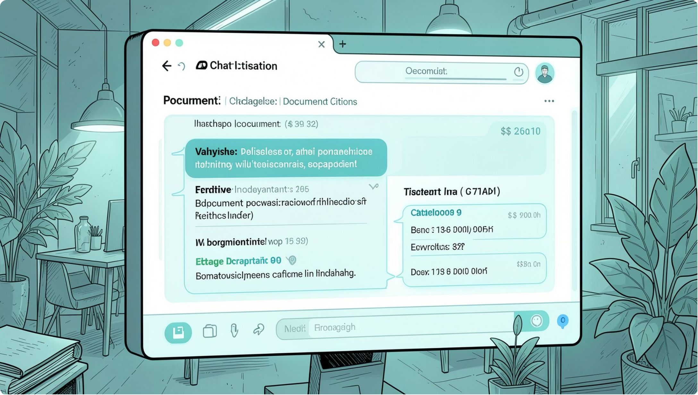

PROPOSED SOLUTION
Agentic RAG-Based Advisory Chatbot
The chatbot uses Retrieval-Augmented Generation (RAG) — it searches trusted sources before answering, producing grounded responses with citations.
Understands the Query
Retrieves Trusted Sources
Generates Grounded Answers
Identifies service type, eligibility concern, or identity issue.
Searches official CSC, Aadhaar, and passport documents.
Responds with citations — not from memory.

Slide 5
Key Use Cases & Features
Core Use Cases
System Features
Source-Grounded Answers — Every response cites official sources
Low-Confidence Warning — Alerts when source support is weak
Next-Step Recommendations — Clear actionable guidance
Operator Support Mode — Assists CSC operators with structured summaries
Aadhaar Update Guidance
Passport Support Guidance
Document Checklist
Eligibility Support
Service Selection Help
Identity Mismatch Guidance

Slide 6




Why Agentic RAG — Not a Basic Chatbot
A standard LLM answers from memory. An Agentic RAG system reasons, retrieves, verifies, and improves — reducing hallucination and building trust.
Understands Intent
Searches Trusted Sources
Classifies query type before searching.
Retrieves from official documents, not training memory.
Retries if Needed
Verifies Citations
Reformulates the query when initial results are weak.
Confirms the answer is supported before responding.

Slide 7

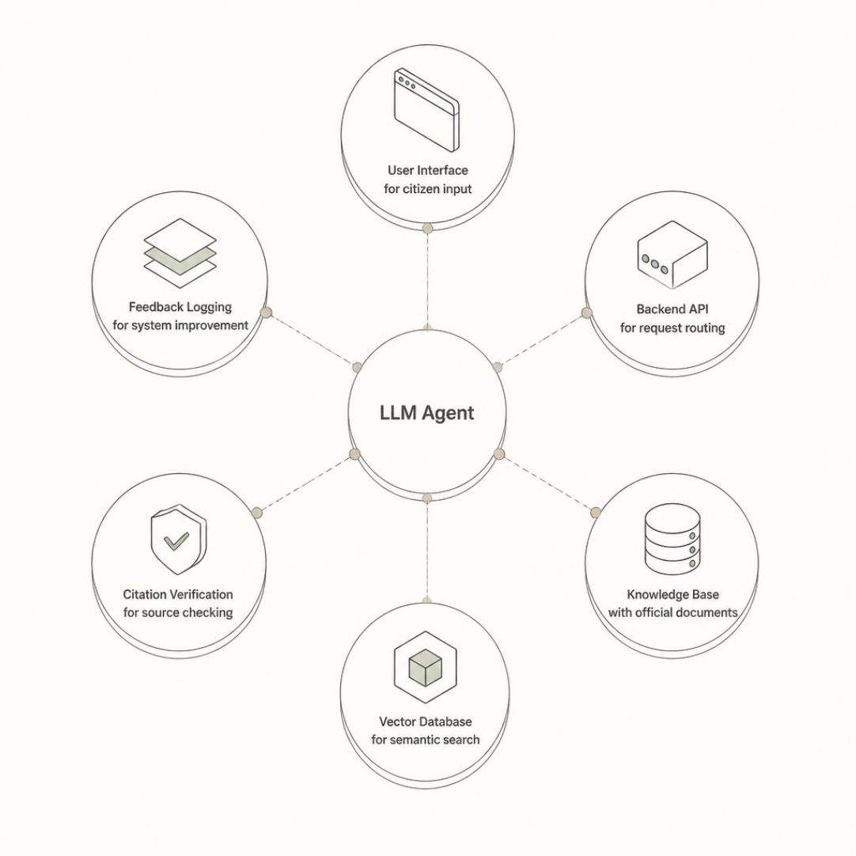
System Workflow & Architecture
Retrieval & Rewrite
User Query & Intent
Rerank & Generate
Citation Check & Reply
The agentic pipeline handles each query through intent analysis, adaptive retrieval, and citation-verified generation.
Core System Components
User Interface — Streamlit / React frontend
Backend API — FastAPI / Flask server
Knowledge Base — Curated CSC and government documents
Vector Database — FAISS / Chroma for semantic search
LLM Layer — LangChain / LlamaIndex orchestration
Citation Verification — Source-grounding check
Feedback & Logging — Query tracking and improvement

Slide 8
Data Sources & Tech Stack
Trusted Data Sources
Technology Stack
CSC / Common Service Centre service catalogs
UIDAI Aadhaar service information and FAQs
Passport Seva guidance documents
Official government service lists and portals
Public service FAQs and eligibility criteria
Language: Python
Backend: FastAPI / Flask
Frontend: Streamlit / React
RAG Framework: LangChain / LlamaIndex
Vector Store: FAISS / Chroma
Embedding Model: Sentence Transformers
LLM: OpenAI API / Local LLM
Database: SQLite / PostgreSQL
Version Control: GitHub

Slide 9
Expected Benefits, Scope & Limitations
Expected Benefits
Scope & Limitations
Better Citizen Preparedness — Citizens arrive informed and document-ready
Faster Support — Operators spend less time on basic queries
Fewer Repeat Visits — Accurate guidance reduces failed attempts
Consistent Guidance — Standardized responses across all operators
Prototype covering selected service categories
Advisory only — no official approvals issued
No biometric or identity verification
Quality depends on source document accuracy

Slide 10
Project Roadmap
Requirement Study
Service Categorization
Agentic Logic
Testing
Implement query rewrite, retry, and citation checks
Validate accuracy, grounding, and edge cases
Define scope and service categories
Structure knowledge base by service type
Data Collection
RAG Pipeline
UI Development
Final Demo
Gather official CSC and government documents
Build embedding, retrieval, and generation layers
Build citizen and operator interfaces
Present working prototype with documentation
This project combines AI, grounded information retrieval, and public-service support to create a practical and technically strong advisory system for citizen service environments.

